Slide 1

CHARACTERIZING DIABETES, DIET, OBESITY & EXERCISE COMMENTS ON TWITTER
SUBMITTED BY: SUBMITTED TO:
Andhavaram Mohan Sai(202IT002) Dr. Sowmya Kamath
Manaswita Datta(202IT011)
S.S.S.Sabareesha(202IT024)
Department of Information Technology, NITK, Surathkal

Slide 2

Content
Introduction
Problem Statement
Methodology
Data Collection
Data pre-processing
Topic Discovery
Latent Dirichlet allocation (LDA)
Linguistic Inquiry and Word Count (LIWC)
Innovation in Methodology
Latent semantic analysis (LSA)
Results and Analysis
Individual contribution
Conclusion & Future work
References

Slide 3
Introduction
Analyse the characteristics of the general public's opinions regarding diabetes, diet, exercise and obesity (DDEO) as expressed on Twitter to find correlations among the DDEO topics.
According to WHO, The global prevalence of obesity has tripled between 1975 and 2016, with more than 1.9 billion adults considered as overweight and over 650 million adults considered as obese.
Overweight and obesity are the fifth leading risk for global deaths according to the European Association for the study of Obesity.
Studies show that there are strong relations among diabetes, diet, exercise, and obesity (DDEO).

Slide 4
Problem Statement
Understanding public health opinions on social media to characterise common health issues such as Diabetes, Diet, Exercise and Obesity(DDEO).
The goal of this research is to analyze the characteristics of the general public's opinions regarding diabetes, diet, exercise and obesity (DDEO) as expressed on Twitter and find notable correlations among the DDEO topics.

Slide 5
Methodology
LSA
Data Collection
Data Cleaning
Evaluate using coherence score and find the optimal topics
LIWC
LDA
Correlation

Slide 6
Methodology
Data Collection: Collect user's opinions on twitter using Twitter API.
Data Cleaning: Pre-process the data obtained.
Topic Discovery: Apply Topic Modelling techniques to discover the topics.
Topic Content Analysis: Making observations about how the topics are related.

Slide 7
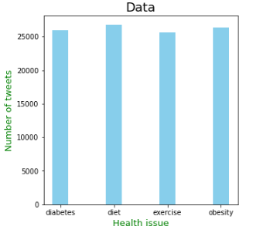
DATASET COLLECTION
Used Twitter API for scraping of tweets
Obtain a total of 104,806 tweets for the pilot task, with 25978, 26789, 25623 and 26416 tweets for diabetes, diet, exercise, obesity respectively.
Tweets related to Diabetes, Diet, Obesity and Exercise have been scraped based on these four queries:
Diabetes: diabetes OR #diabetes
Diet: diet OR #diet OR dieting
Exercise: exercise OR #exercise OR exercising
Obesity: obesity OR #obesity OR fat

Slide 8
DATA PRE-PROCESSING
For pre-processing the tweets, the following steps are performed:
Removing irrelevant characters and links
Converting all the characters to lowercase
Removing contractions
Removing punctuations
Removing extra whitespaces
Removing empty tweets
Removing non-English words
Removing stop words

Slide 9
Topic Discovery
Topic Discovery or modelling is a type of statistical model for discovering the abstract "topics" that occur in a collection of documents.
Topic modelling is a method for unsupervised classification of documents, similar to clustering on numeric data, which finds some natural groups of items or topics.
Topic Modelling can help with:
Discovering the hidden themes or topics in a document or corpus.
Classifying the document into discovered themes or topics.
Here we are using two types of topic modelling namely Latent Semantic Analysis (LSA), Latent Dirichlet Allocation (LDA)

Slide 10
Steps for Topic Discovery
Each document is just a collection of words or a “bag of words”. Thus, the order of the words and the grammatical role of the words are not considered in the model.
Number of topics k is pre-decided.
We can sort the words with respect to their probability score. The top x words are chosen from each topic to represent the topic. If x = 10, we’ll sort all the words in topic1 based on their score and take the top 10 words to represent the topic.

Slide 11
Latent Dirichlet Allocation
•Latent Dirichlet Allocation(LDA) uses Dirichlet priors for the document-topic and word-topic distributions, lending itself to better generalization.
•Aim of LDA is to find topics a document belongs to, based on the words in it.
LDA considers corpus is made up of multiple topics, those topics which then generate words based on the probability distribution.
LDA is an effective computational linguistics model for discovering topics in a corpus.
Used the mallet implementation of LDA.

Slide 12
Latent Dirichlet Allocation (2)
Steps for LDA:
The processed data is lemmatized keeping only noun, adjective, verb using spacy.
Using this lemmatized tokens, we form a dictionary and document term matrix.
This dictionary and document term matrix is inserted into the mallet LDA model.
Initially, no. of topics provided to the model is 20 which gives us a coherence score of 0.3503.
Optimal no. of topics for the LDA is 292 with coherence score of 0.5473.

Slide 13
Innovation: Latent Semantic Analysis
LSA, which is also used for Topic Modelling is a technique in NLP, especially in distributional semantics. It analyses the relationship between a set of documents and the terms these documents contain.
LSA (Latent Semantic Analysis) uses bag of word(BoW) model, which results in a term-document matrix(occurrence of terms in a document). Rows represent terms and columns represent documents.
LSA learns latent topics by performing a matrix decomposition on the document-term matrix using Singular value decomposition. LSA is typically used as a dimension reduction or noise reducing technique.

Slide 14
Latent Semantic Analysis(2)
The main challenge is that the matrix is very sparse (or high dimension) and noisy (or include lots of low frequency word). So truncated SVD is adopted to reduce dimension.
The idea of SVD is finding the most valuable information and using lower dimension t to represent same thing.
This dictionary and document term matrix is inserted into the LSA model.
Initially, no. of topics provided to the model is 20 which gives us a coherence score of 0.2342.
Optimal no. of topics for the LSA is 292 with coherence score of 0.4235.

Slide 15
Linguistic Inquiry and Word Count
Topic content analysis is used to determine the presence of certain words, themes, or concepts within some given qualitative data.
Linguistic Inquiry and Word Count (LIWC) is a linguistics analysis tool that reveals thoughts, feelings, personality, and motivations in a corpus.
LIWC has a health-related dictionary that can help to find whether a topic contains words associated with health.
We are using LIWC2015 in this project, which is considered as the best standard in computerized text analysis.

Slide 16
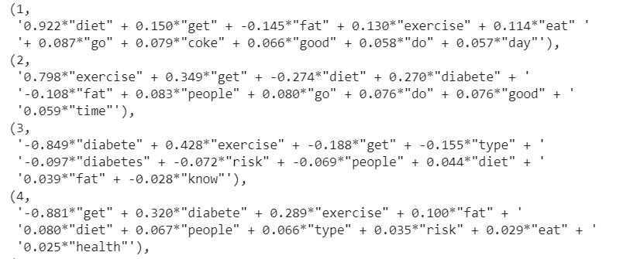
Results and Analysis
Snippet of topics from the topic modelling: The optimal topics obtained from the Topic modelling techniques which can also be used to calculate the correlation between the topics.

Slide 17
Results and Analysis
Coherence Score: Topic Coherence measures score a single topic by measuring the degree of semantic similarity between high scoring words in the topic. These measurements help distinguish between topics that are semantically interpretable topics and topics that are artifacts of statistical inference.
Modelling Technique | Optimal no of topics | Coherence score
LDA | 292 | 0.5473
LSA | 292 | 0.4235

Slide 18
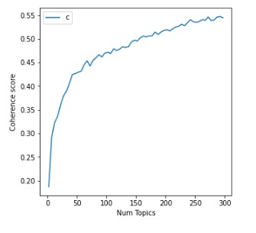
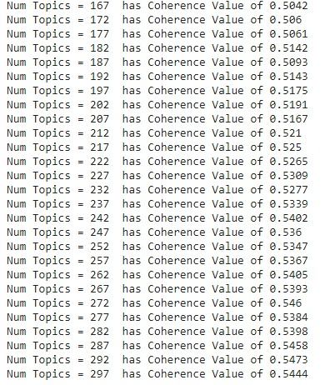
Results and Analysis
Coherence score Vs Number of topics in LDA:

Slide 19
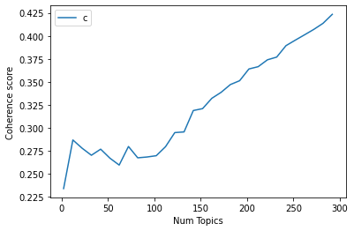
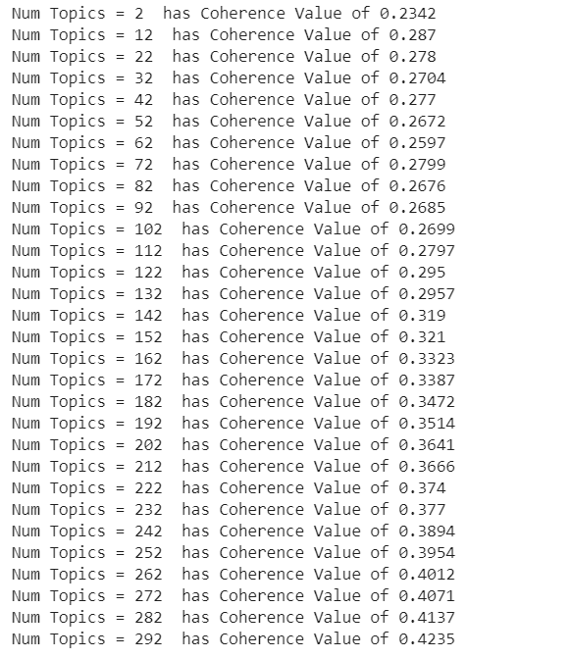
Results and Analysis
Coherence score Vs Number of optimal topics in LSA:

Slide 20
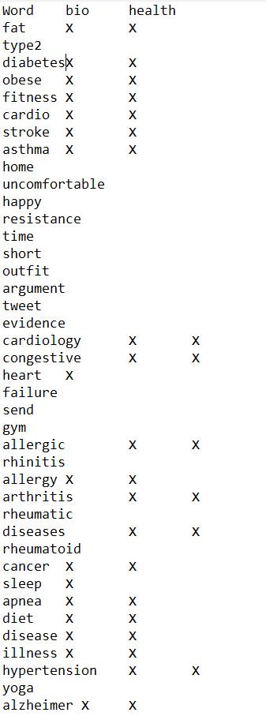
Results and Analysis
Health related topics in Optimal topics by LIWC:
LIWC found 60 health related topics in 292 optimal topics and labeled them into diet, diabetes, exercise and obesity. The correlation of found 60 health related topics is plotted.

Slide 21
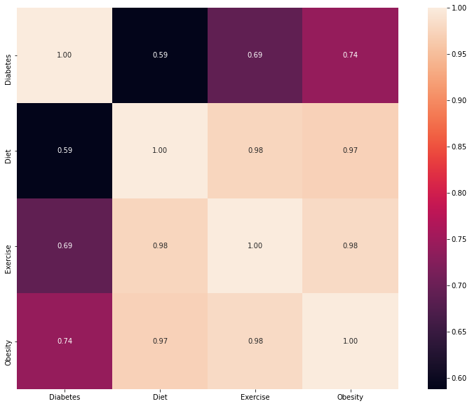
Results and Analysis
Correlation plot between the topics:
The strongest correlation was found between topics Exercise and Diet (0.98) and lowest correlation between Diet and Diabetes(0.59).

Slide 22
Contribution
Dataset collection – Mohan, Manaswita, Sabareesha
Pre-processing – Mohan, Manaswita, Sabareesha
LDA Topic Modelling - Manaswita
LSA Topic Modelling - Sabareesha
Topic analysis using LIWC, finding the correlation- Manaswita, Sabareesha, Mohan

Slide 23
Conclusion and Future Work
LDA gave a better coherence score for the same number of optimal topics because LSA was mostly concentrated on the dimensionality reduction.
The diabetes had the most common sub-topic as type 2 diabetes and other non-health related topics such as yoga.
Similarly for diet, the most common sub-topic was fat and weight loss.
The correlation between these topics show the strongest correlation between the topics exercise and obesity. The lowest correlation was found between topics diabetes and obesity.
The work can be extended to other health related techniques too for a better understanding of public opinions on social media

Slide 24
References
Arnold, C., & Speier, W. (2012). A topic model of clinical reports. Proceedings of the 35th international ACM SIGIR conference on research and development in information retrieval. ACM1031–1032.
Association, A. D., et al. (2004). Physical activity/exercise and diabetes. Diabetes Care, 27(suppl 1), s58–s62.
Hong, L., & Davison, B. D. (2010). Empirical study of topic modeling in Twitter. Proceedings of the first workshop on social media analytics. ACM80–88.

Slide 25

Thank You

